Slide 1


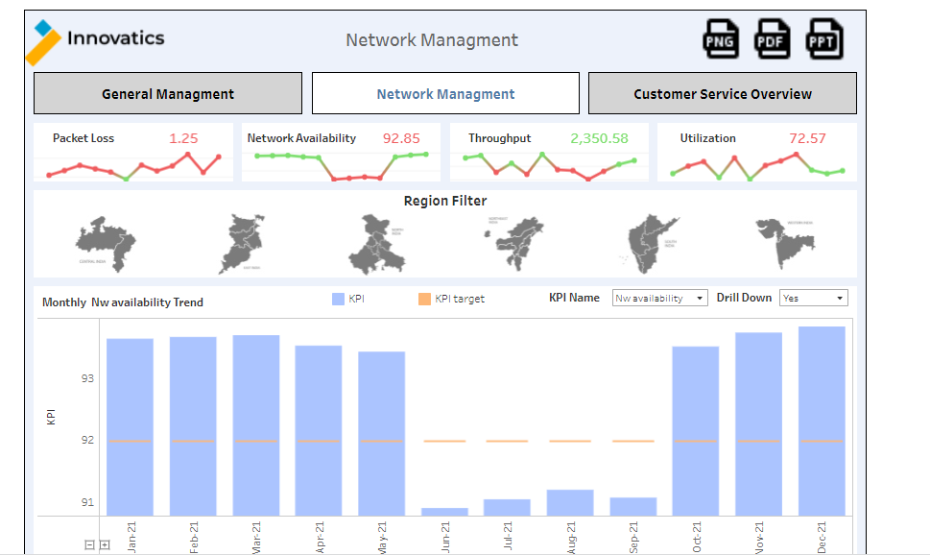
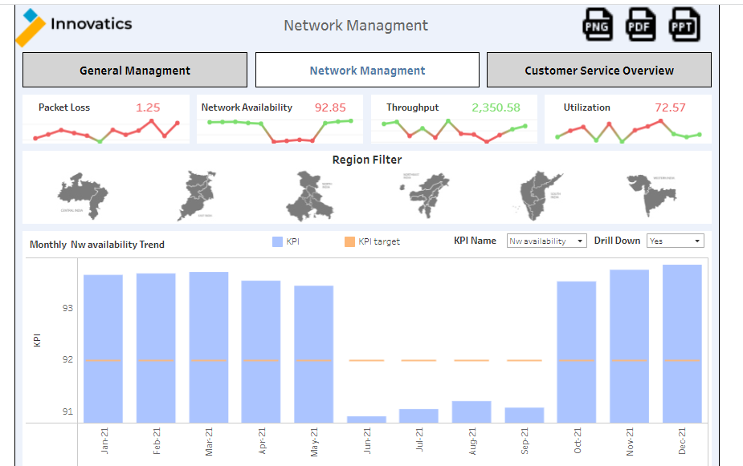
Telecom Industry Dashboard
Motive
Analytics Pipeline
Major Challenges
Since the company is Serving in Indian market with major all state where check customer behavior and mainly focus on reduce churn rate and increase revenue.
Our Solution
There are 3 Dashboard mainly to solve problem in 3 stages.
Management level With improve Management KPI track and improve
Network level with network performance improve and tracking
customer level using complain improvement and customer overall history .
Marketing Tools and Platforms
Data Transformation
Business Intelligence Tools
Overall data taken for network dashboard from Network server on day level and then perform and check KPI data
Customer level data taken from customer portal HPSM where overall customer details
All received data will be stored and when require use of SQL and Excel work for further.
Monthly,weekly and daily refresh plan for updated data.
Track geography, Segment as well demographic segment with KPI.
Dashboard Sample and Use Case
Dashboard
Benefits
Different KPI performance and tracking using this dashboard also get more granularity on week as well day level with geographic bifurcation
Analysis at multiple granularities: Time duration, KPI, Geography.
Management can check Geography wise Worst and best region as well state and then make further plan for improvement in network.
Ad-Hoc Reports for daily tracking and actions.
This dashboard shows a portion of what information can be viewed by Network Employee at the HQ.
The use case shown here is for the performance of the Network with different main KPI on daily weekly and monthly basis as well detail bifurcation in Region and states for deep dive analysis.
.Top and Bottom perform Region and state also identify and which help to improve network performance.
* Estimated

